Slide 1

Ant Colony Systems and the
Ant Algorithm

Slide 2
REAL ANT BEHAVIOR

Slide 3
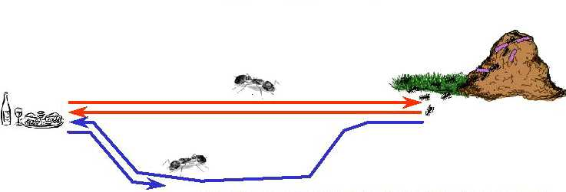
REAL ANT BEHAVIOR
Natural behavior of ants have inspired scientists to mimic insect operational methods to solve real-life complex problems
By observing ant behavior, scientists have begun to understand their means of communication
Ant-based behavioral patterns to address combinatorial problems - first proposed by Marco Dorigo
Ants secrete pheromone while traveling from the nest to food, and vice versa in order to communicate with one another to find the shortest path

Slide 4
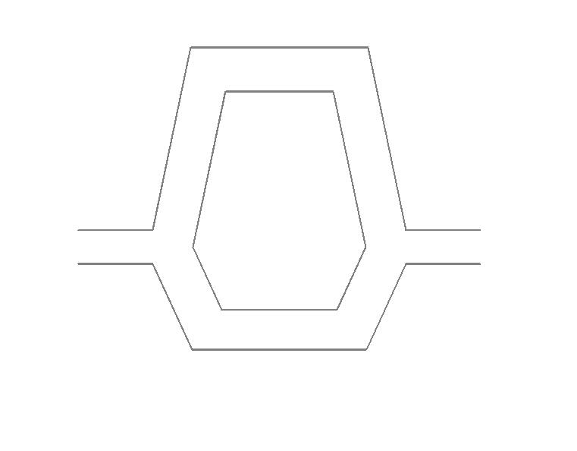
EXPERIMENTAL STUDY OF ANTS
The more ants follow a trail, the more attractive that trail becomes for being followed
NEST
NEST
NEST
FOOD
FOOD
FOOD

Slide 5
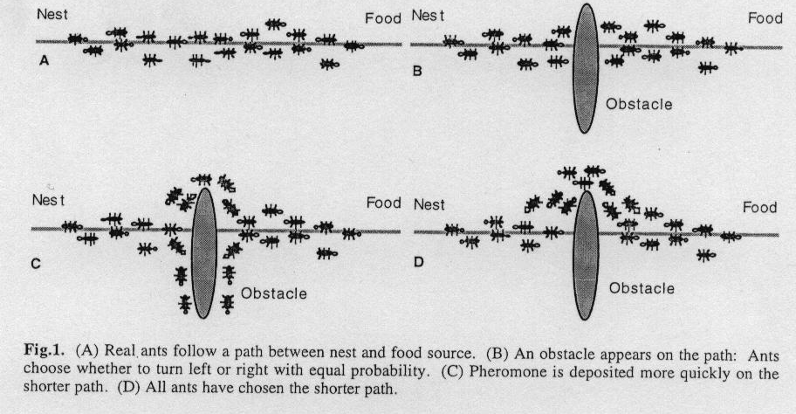
ANT Behavior
The more ants follow a trail, the more attractive that trail becomes for being followed

Slide 6
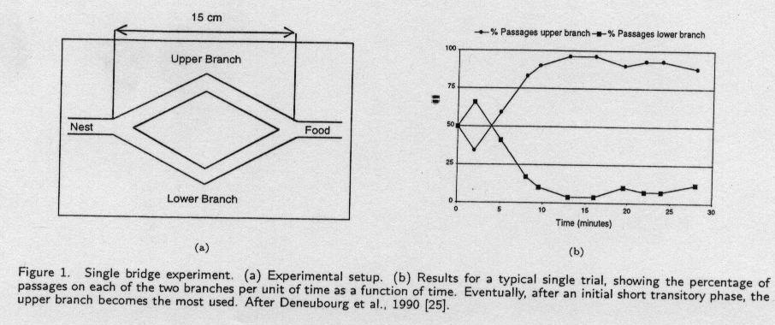
ANT Behavior
Even when the tracks are equal the behavior will encourage one over the other--convergence (Deneubourg et al)

Slide 7
ROUTE SELECTION
Ants are forced to decide whether they should go left or right, and the choice that is made is a random decision
Pheromone accumulation is faster on the shorter path
The difference in pheromone content between the two paths over time makes the ants choose the shorter path
Positive feedback mechanism to arrive at the shortest route while foraging
  Stygmergy or stigmergetic model of communication
Different optimization problems have been explored using a simulation of this real ant behavior

Slide 8
TRAVELING SALESMAN PROBLEM

Slide 9
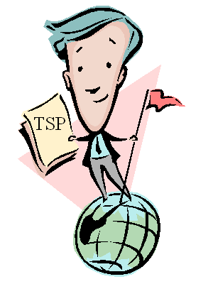
PROBLEM DEFINITION
OBJECTIVE
Given a set of n cities, the Traveling Salesman Problem requires a salesman to find the shortest route between the given cities and return to the starting city, while keeping in mind that each city can be visited only once

Slide 10
WHY IS TSP DIFFICULT TO SOLVE?
Finding the best solution may entail an exhaustive search for all combinations of cities. This can be prohibitive as “n” gets very large
Heuristics like a “greedy” route doesn’t guarantee optimal solutions
a
d
a
d
e
e
b
f
g
b
f
g
c
c
h
h

Slide 11
TSP Applications
Lots of practical applications
Routing such as in trucking, delivery, UAVs
Manufacturing routing such as movement of parts along manufacturing floor or the amount of solder on circuit board
Network design such as determining the amount of cabling required
Two main types
  Symmetric
  Asymmetric

Slide 12
General Formulation - Symmetric

Slide 13
General Formulation - Asymmetric

Slide 14
TSP Heuristics
Variety of heuristics used to solve the TSP
The TSP is not only theoretically difficult it is also difficult in practical application since the tour breaking contraints get quite numerous
As a result there have been a variety of methods proposed for the TSP
Nearest Neighbor is a typical greedy approach

Slide 15
Simple Examples

Slide 16
Nearest Neighbor Solution

Slide 17
Larger TSP Example
Obj Fx: min d

Slide 18
Initial Order Solution
d=3138

Slide 19
Nearest Neighbor Solution
d=2108

Slide 20
Tabu Search Solution
d=1830

Slide 21
THE ANT COLONY OPTIMIZATION METAHEURISTIC

Slide 22
GOAL OF ACO HEURISTIC
Artificial ants form a multi-agent system performing the functions as observed in the real ant system
Exploit stigmergistic communication
The ACO meta-heuristic relies on the co-operation of a group of artificial ants to obtain a good solution to a discrete optimization problem such as the TSP
Artificial ants are mutants of a real ant system
The resulting shortest route mapping determined by the agents can be applied to the optimization problem

Slide 23
ACO CHARACTERISTICS
Exploit a positive feedback mechanism
Demonstrate a distributed computational architecture
Exploit a global data structure that changes dynamically as each ant transverses the route
Has an element of distributed computation to it involving the population of ants
Involves probabilistic transitions among states or rather between nodes

Slide 24
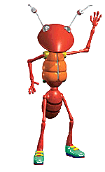
REAL vs. ARTIFICIAL ANTS
Discrete time steps
Memory Allocation
Quality of Solution
Time of Pheromone deposition
Distance Estimation
REAL ANT
ARTIFICIAL ANT

Slide 25
FLOWCHART OF ACO
START ACO
Locate ants randomly
in cities across the
grid and store the
current city
in a tabu list
Have the
maximum
Iterations been
performed
NO
YES
STOP
ACO
Determine probabilistically
as to which city to visit next
NO
Determine the shortest
tour till now and
update pheromone
Have all
cities been
visited
Move to next city and
place this city in the
tabu list
YES
Record the length of
tour and clear tabu list

Slide 26
KEY PARAMETERS
Trail intensity is given by value of τ_{ij} which indicates the intensity of the pheromone on the trail segment, (ij)
Trail visibility is η_{ij} = 1/d_{ij}
The importance of the intensity in the probabilistic transition is α
The importance of the visibility of the trail segment is β
The trail persistence or evaporation rate is given as ρ
Q is a constant and the amount of peromone laid on a trail segment employed by an Ant; this amount may be modified in various manners

Slide 27
PROBABILISTIC CITY SELECTION
Helps determine the city to visit next while the ant is in a tour
Determined by variables such as the pheromone content in an edge (i,j) at time instant t, heuristic function of the desirability of adding edge, and their control parameters

Slide 28
PHEROMONE UPDATING
Using the tour length for the k-th Ant, L_{k}, the quantity of pheromone added to each edge belonging to the completed tour is given by
The pheromone decay in each edge of a tour is given by

Slide 29
ACTUALLY 3 ALGORITHMS
The ant-cycle is the approach discussed so far
  Information is updated at the end of each tour as such function of tour length
The ant-density is an approach wherein the pheromone quantity Q is deposited once the segment is transversed
  Pretty much a greedy approach (local information) and not really providing relative information
The ant-quantity is an approach wherein the pheromone quantity Q/d_{ij} is deposited once the segment is transversed
  Also a greedy approach but providing some relative information by scaling Q by the length of the segment

Slide 30
Consider the Case Studies in Papers

Slide 31
EXTENSIONS
Found that communication among the ants via the intensity factor is important; makes sense since it provides some global insight
Found that a good number of ants is about equal to the number of cities
Found that the initial distribution of the ants among the cities does not really matter
Found that an elitist strategy in which the segments on the best solution(s) is(are) continually reinforced work well so long as there were not too few or too many elitist solutions

Slide 32
APPLICATIONS

Slide 33
APPLICATIONS

Slide 34
Population-Based Incremental Learning
Lots of similarities to the ACO
Actually inspired by genetic algorithms
Generate members of a population randomly based on probability of selection functions that are increased or decreased based on the quality of past solutions involving the member variables
Once a population is generated, evaluate and then increase or lower the probability used by the generating vector to encourage better solutions.

Slide 35
Population-Based Incremental Learning
Benefits
  Will converge to solutions under correct circumstances
  Efficient in terms of storage
  Computationally pretty cheap
  Involves learning
Disadvantages
  Keeps primarily a local focus
  Cannot handle interdependence among parameters very well
  Will need to involve penalty functions for constraints

Slide 36
Population-Based Incremental Learning
A solution to overcome disadvantages proposed by Miagkiky and Punch
Combine reinforcement with population generation

Slide 37
QUESTIONS??

